Slide 1
Accessory Dwelling Units
as a solution for
Housing Shortage
Khairun Fahmi & Salma Haoudi
URSP 688Y

Slide 2
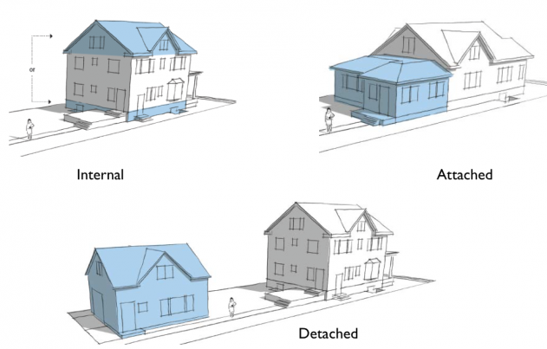
What is an ADU?

Slide 3
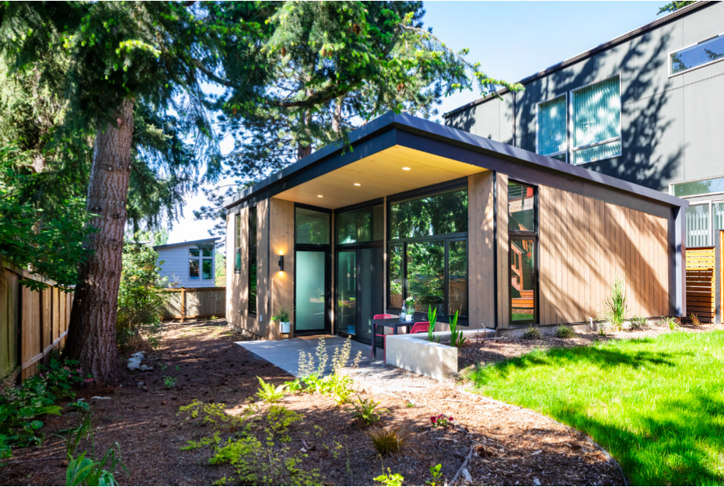
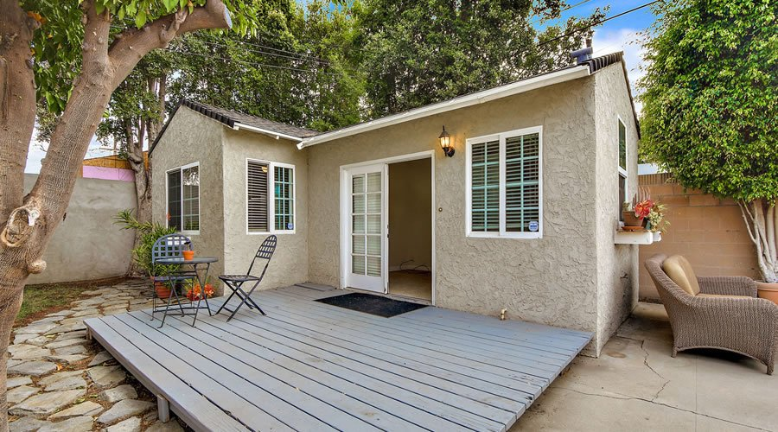
What is an ADU?
Seattle Image : Seattle ADU Report
California Image : S3DA

Slide 4
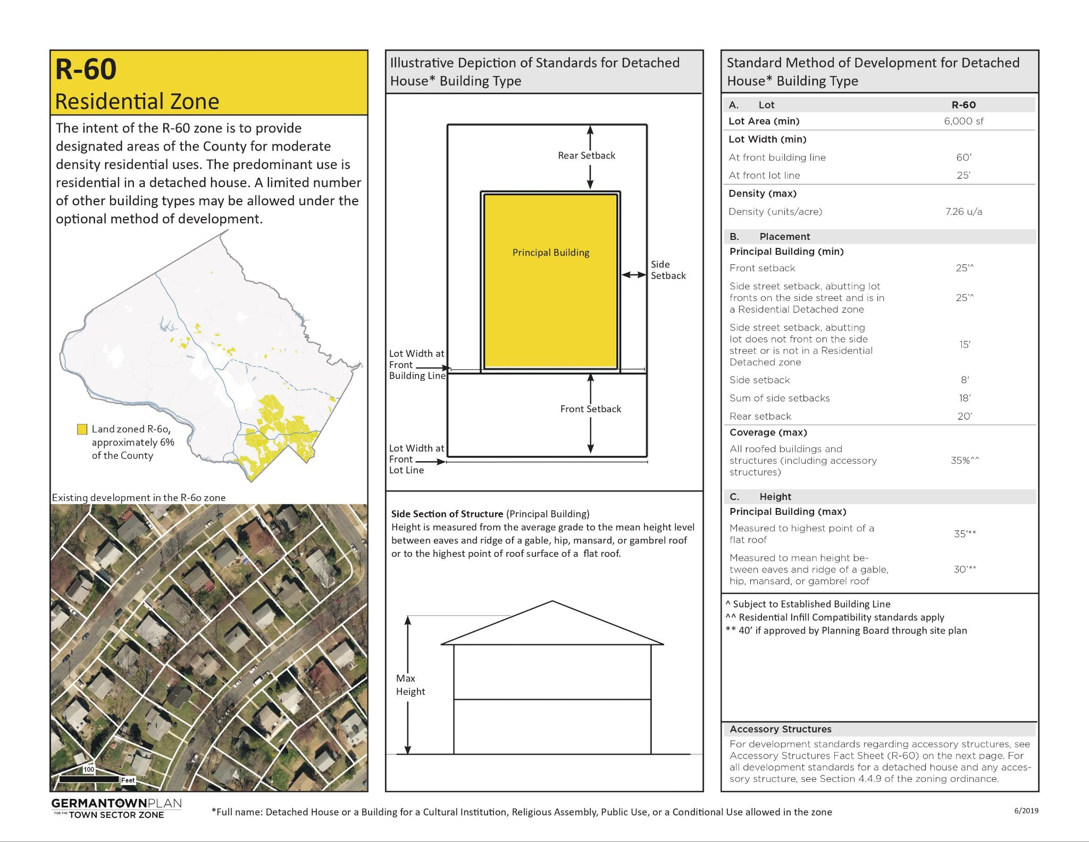
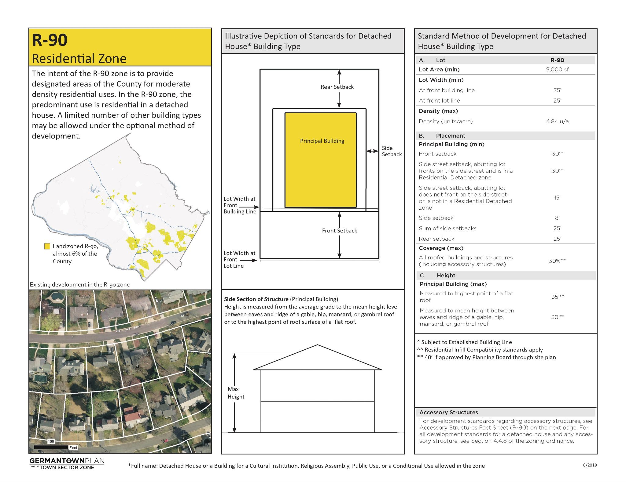
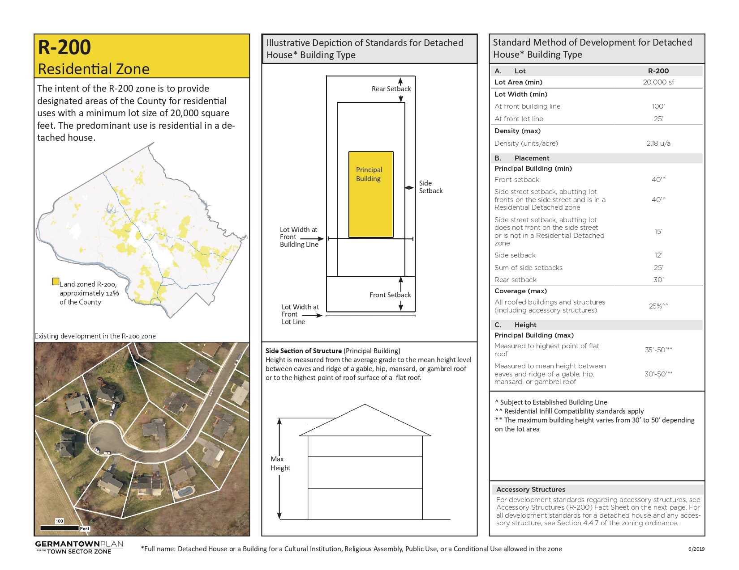
Brief background
In Montgomery County, homeowners can built an ADU in R-60, R-90, R-200 residential zoning to rent it.

Slide 5
However …
The county requires more off-street parking for ADUs if they are located more than 1 mile away from a metro station.

Slide 6
Definitions
In Montgomery County, there are 3 types of Accessory Unit Licenses:
ACC - ADUs approved prior to May 20, 2013 under Special Exception or Conditional Use standards Approved, License issued
ACC3 - ADUs (Class 3 License) approved since May 20, 2013 that meet Limited Use standards
RLU - Registered Living Units for family and caregivers that cannot charge rent, Application Processing
Notes:
Registered Living Units(RLU) are basically non-rentable ADUs that only family members can use, and if local government, currently you have to go through long process to turn an RLU into an ADU

Slide 7
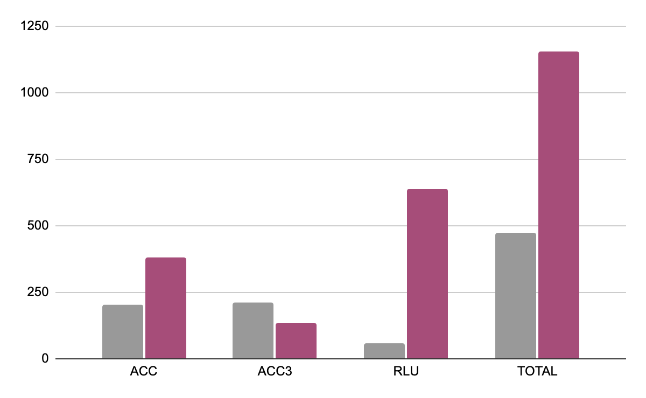
ADUs (specially RLUs) have been increasing in Montgomery County since 2019
Permit issued before 2019
Application Processing in 2024

Slide 8

Research question
Notes:
Our research question is: what on earth goes in the theeeese accessory Units,
And it seems like it is one of the to 10 questions science can’t answer
So we are honored to be among the top researchers researching that

Slide 9
Research question
Since Montgomery County requires more off street parking for ADUs located more than 1mile away from a metro station
What is the correlation between Accessory Dwelling Units’ (ADU’s) development and proximity to metro stations in Montgomery County?
Notes:
More seriously, our research question is Since Montgomery County requires more off street parking for ADUs located more than 1mile away from a metro station, What is the correlation between Accessory Dwelling Units’ (ADU’s) development and proximity to metro stations in Montgomery County?

Slide 10
Objectives and Process
Measure patterns of ADU development
Assess the number of ADU applications within 1 mile of metro stations
Assess the potential number of RLUs that can become ADUs though regulatory streamlining
How many ADUs, RLUs, and ACC3 are within 15 min walk from metro stops in Montgomery County?
Notes:
Our objectives are to measure patterns of ADU DEVELOPMENT by assessing the number of ADU license applications within 1 mile of metro stations
And assessing the potential number of RLUs than can become ADUS so that they are rentable to people

Slide 11
Methods
Department of Housing and Community Affairs (DHCA) has an interactive site that shows applications for accessory units,
#Copied the data from the attribute table from https://gis4.montgomerycountymd.gov/ADU/ website,
#Added crs data to make the geodataframe
Notes:
We had a lot of issues to find the data, we were hoping to get the data from the Department of Housing and Community Affairs (DHCA), but surpriiiiiiise
Fahmi ended up copying it from the attribute table from MoCo website,
We added crs data to made geodataframe

Slide 12
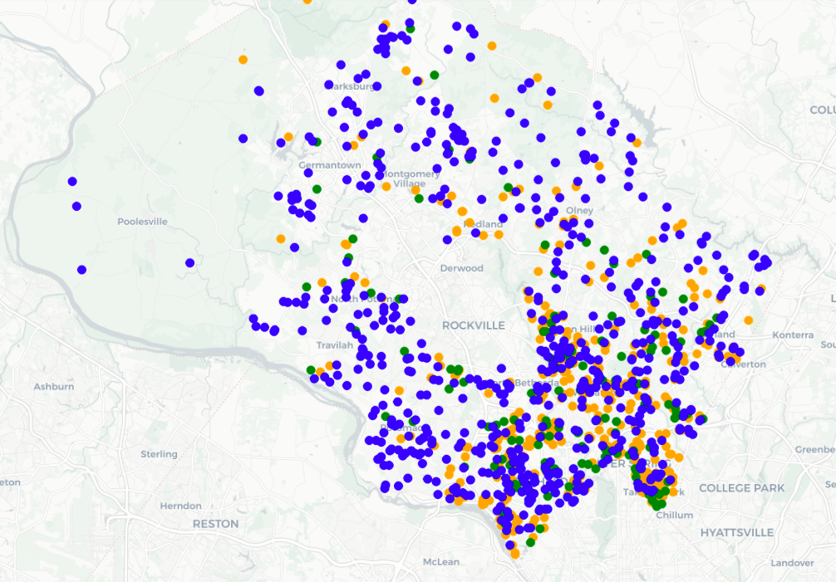
Methods
#Mapped ACC, ACC3 and RLUs in different color code in a folium map
Notes:
We mapped the ACC, ACC3 and RLUs in different color code in a Folium map because we wanted to zoom in and out to be able to see the data more clearly

Slide 13
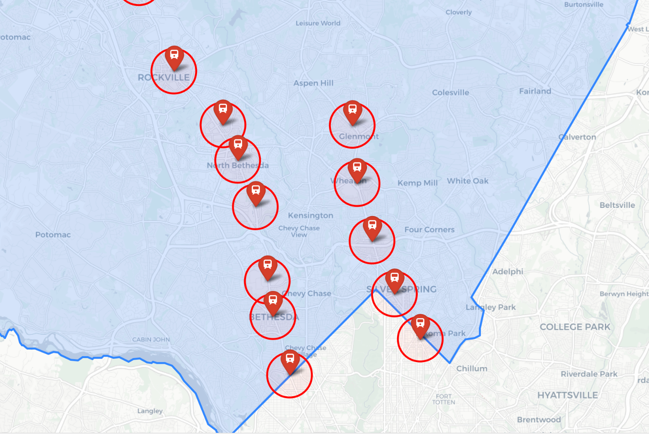
Methods
#Mapped Metro stations in MoCo and a 1 km buffer around them
Notes:
We Mapped Metro stations in MoCo and a 1 km buffer around them

Slide 14
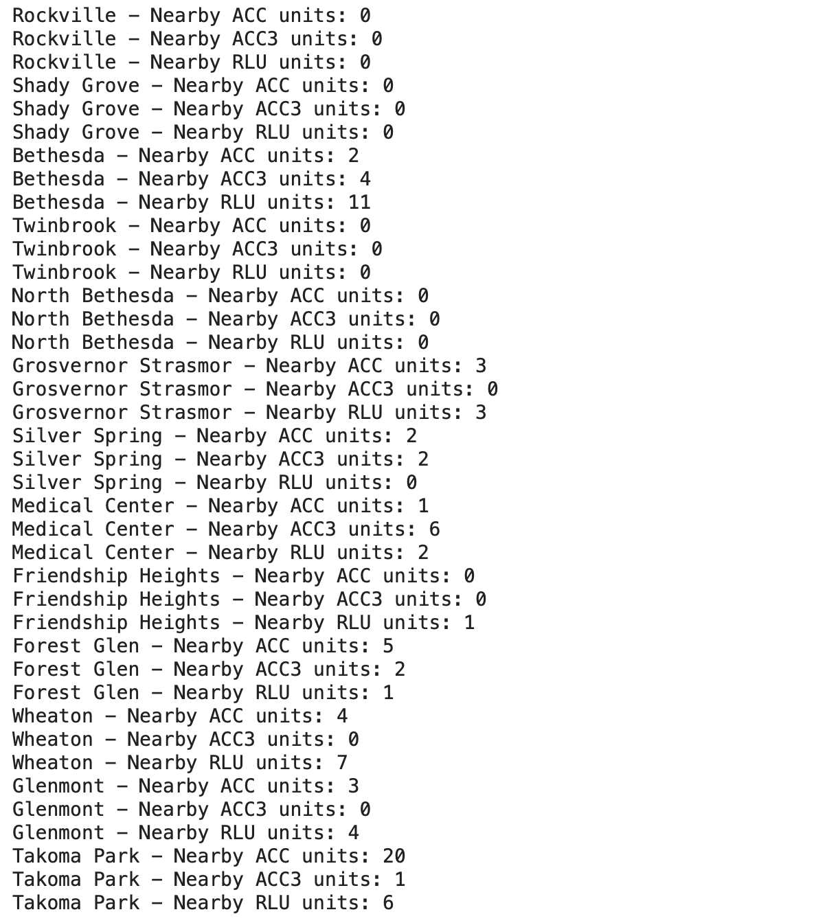
Methods
#Mapped intersections of ADUs within 1 km of these metro stations
#Calculated the number of ACC, ACC3, RLU in this 1km buffer from metro stations
Notes:
We Mapped intersections of ADUs within 1 km of these metro stations
We Calculated the number of ACC, ACC3, RLU in this 1km buffer from metro stations

Slide 15
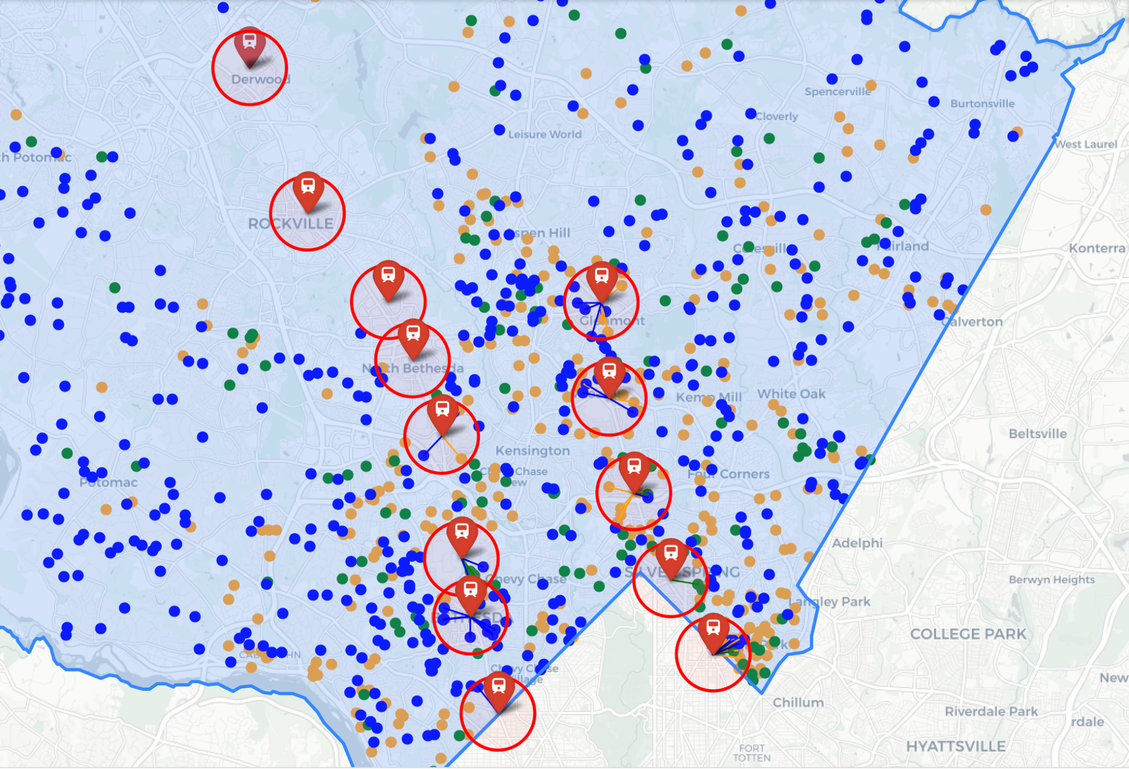
Results
ACC
ACC3
RLU
Notes:
And heeere are the resuuuults …
When mapping the different types of ADUs and the metro stops, it appeared to us that there is not specific correlation between ADU development and location of metro stations. In fact, if we look at Rockville station or Shady Grove for example, we see that the area does not show any ADU nearby.

Slide 16
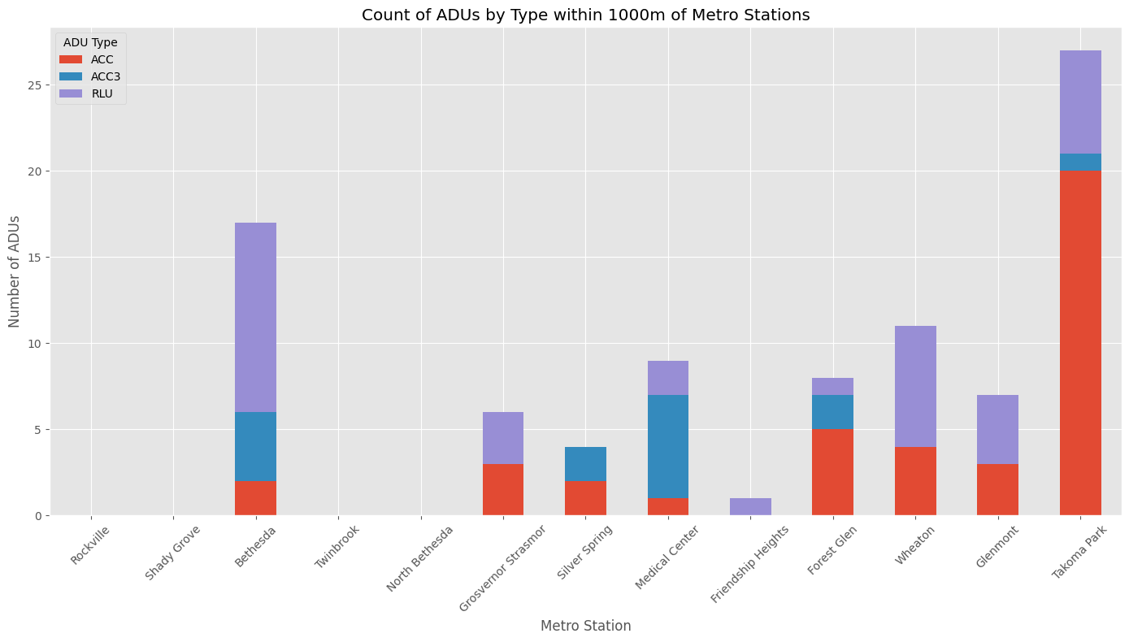
Results
Notes:
Also, it appears that people who applied for the most RLU permits are nearby bethesda station and those who applied for the most ACC’’s are within takoma park, meanwhile those who applied for the most ACC3 are nearby medical center. This implies that there needs to be further research to study the correlation between ADUs and socio-economic aspects as Takoma Park and Bethesda have different median income levels.

Slide 17
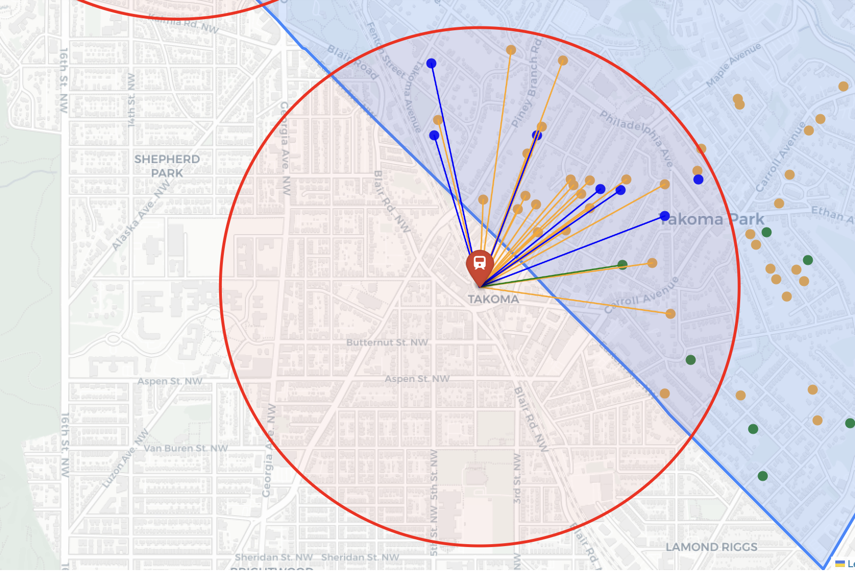
Results
Takoma
Park
Station
ACC
ACC3
RLU
Notes:
We can see the higher number of acc within takoma park.

Slide 18
Implications and Limitations
The ADUs distribution patterns on the map do not reveal any correlation between metro stops locations and ADUs development in Montgomery County. But existence of ADUs around Metro’s suggest potential for proliferation of ADUs as middle housing.
Most ongoing Applications are for RLUs. If RLUs are licensed as ADUs, this type of housing will roughly double.
More qualitative and quantitative research need to be done on parking requirements, impact fees, zoning requirements, restrictive covenants and the socio-economic aspects of Montgomery county to be able to define what has a strong correlation with ADUs development.
Notes:
Most ongoing Applications are for RLUs. If RLUs are licensed as ADUs, this type of housing will roughly double.
More qualitative and quantitative research need to be done on parking requirements, impact fees, zoning requirements, restrictive covenants and the socio-economic aspects of Montgomery county to be able to define what has a strong correlation with ADUs development.
Can't prove correlation.

